Slide 1
Assessment in Action: Screening Considerations in School Mental Health Quality and Evidence-Based Practice Strand 20th Annual Conference on Advancing School Mental Health 2015
Dr. Faith Miller, University of Minnesota
Dr. Sandra Chafouleas, University of Connecticut

Slide 2
Agenda & Purpose
Discuss the importance of screening
Provide an overview of contemporary screening approaches
Discuss practical and logistical considerations related to screening
School Mental Health

Slide 3
Objectives
Participants will be able to identify a minimum of 5 different screening methods
Participants will be able to describe strengths and weaknesses associated with at least 3 different screening methods
Participants will be able to identify factors impacting the number of times screenings should occur

Slide 4
Assessment
Data-based decision-making
Intervention
Assessment as Evidence-based Practice
We need reliable and valid data in order to engage in EBP
Foundational
Understanding the strengths and limitations of our assessments is essential

Slide 5
Why do I need the data?
At what level should the problem be solved?
Primary
Secondary
Tertiary
What is the purpose of assessment?
Evaluative
Diagnostic
Progress Monitoring
Screening

Slide 6
Purpose of Assessment
Screening
Who needs help?
Diagnosis
Why is the problem occurring?
Tied to service delivery (SPED)
Progress Monitoring
Is the intervention working?
Evaluation
How well are we doing overall?
Emphasized within a Multi-Tiered Service Delivery Framework (RTI)

Slide 7
Screening
Screening involves the process of narrowing a larger general population down to a smaller population of interest, based on specific characteristics (Merrell, 2008)
Screening informs service delivery at subsequent tiers

Slide 8
Rationale
Surveillance within a prevention-science paradigm
General outcome measures as indicators of status
Early Identification
Early Intervention
Positive Student Outcomes
Notes:
Public Health surveillance is currently endorsed by the Centers for Disease Control and Prevention (Hall, Correa, Yoon, & Braden, 2012), and is defined as follows: The ongoing, systematic collection, analysis, and interpretation of health data, essential to the planning, implementation and evaluation of public health practice, closely integrated with the dissemination of these data to those who need to know and linked to prevention and control. (Thacker & Berkelman, 1992, p. 1)
Applying this approach to the delivery of school-based services, Herman, Riley-Tillman, and Reinke (2012) argue that a surveillance approach can be implemented in schools within a prevention science paradigm in which thoughtfully collected data guide service delivery,which results in meaningful impacts on critical academic and behavioral outcomes for student populations. Within a multi-tiered problem-solving framework, effective surveillance depends on the accurate definition, identification, and thus, detection of problem behavior.

Slide 9
Why do we need to screen? (Severson et al., 2007)
Referral peak for academic problems = 2nd/3rd grade
Referral peak for behavioral problems = 9th grade
One estimate suggests that 75-80% of children and youth in need of mental health services do not receive them (Kataoka, Zhang, & Wells, 2002)

Slide 10
Benefits of screening
Long term costs of NOT screening
Suspension/expulsion
Dropout
Poor employment outcomes
44% of those receiving federal disability payments have a serious mental illness
Incarceration
According to the National Alliance on Mental Illness, 40% of adults with serious mental illness are arrested at some point
Suicide: 39,000 deaths per year (CDC)
Time and resources devoted to behavior issues
Early identification → Early intervention→ Improved student outcomes

Slide 11
USA Today (2014)

Slide 12
Screening: Is it happening?
Mandatory universal screening for behavioral health issues does not currently exist anywhere (Weist et al., 2007)
Why don’t schools regularly engage in screening? (Severson et al., 2007)
See it as someone else’s responsibility
Lack of resources
Concerns regarding stigmatization
Availability of schools to provide follow-up services

Slide 13
Bruhn et al. (2014)

Slide 14
Screening Approaches

Slide 15
Key considerations in school-based screening
Constructs of interest
Psychopathology
School-based success
Risk and protective factors
What are we screening for???
Goal = to identify symptoms related to particular diagnosis
Goal = to identify individual and environmental factors most likely to predict negative outcomes
Goal = to identify behaviors most relevant to ability to learn
Notes:
Research has suggested that these types of risk/resilience evaluations may predict behavioral outcomes better than initial symptomology ratings (Vance, Bowen, Fernandez & Thompson, 2002).
Research suggests that it is important to include both prosocial behavior and
problem behavior as each uniquely predict student behavioral outcomes, and are thus important in supporting early identification of behavioral and emotional risk (Kwon, Kim, & Sheridan, 2012).

Slide 16
Screening options
Extant data: Office discipline referrals
Nomination methods
Teacher/Parent nomination
Sociometrics
Norm-referenced ratings
BASC-2 BESS
DBR-SIS
SDQ
BIMAS
Criterion-referenced ratings
SSIS Performance Screening Guide
Student Risk Screening Scale (SRSS)
Multiple-gating approaches
SSBD
Scope:
Universal
or Targeted
Respondent:
Teacher, Parent, and/or Student

Slide 17
Screening Methods: Extant data & Nomination
ODRs
SWIS
Other
Teacher nomination
Parent nomination
Sociometrics
Strengths
Weaknesses

Slide 18
Norm Referenced Rating Scale
BASC-2 Behavioral and Emotional Screening System (Kamphaus & Reynolds, 2007)
Preschool-Grade 12
27 items used to screen for behavioral and emotional problems
Completed by teachers, parents, and students (3rd+)
$136 for full kit; $28 for package of 25 forms
Requires 5-10 minutes per student
Online scoring available
Intervention recommendations available online (from BASC-2 Intervention Guide)
Strengths
Weaknesses

Slide 19
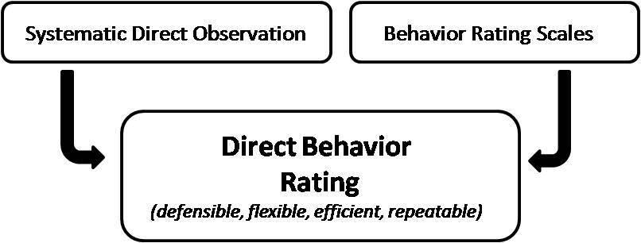
Norm Referenced Rating
Direct Behavior Rating – Single Item Scales
Validated for elementary and middle school use
Combines benefits of systematic direct observation with rating scales
Available for free online: www.directbehaviorratings.org
Teacher observations of student behavior over 5 days (rating 2x per day)
Target behaviors: Academically Engaged, Disruptive, Respectful

Slide 20
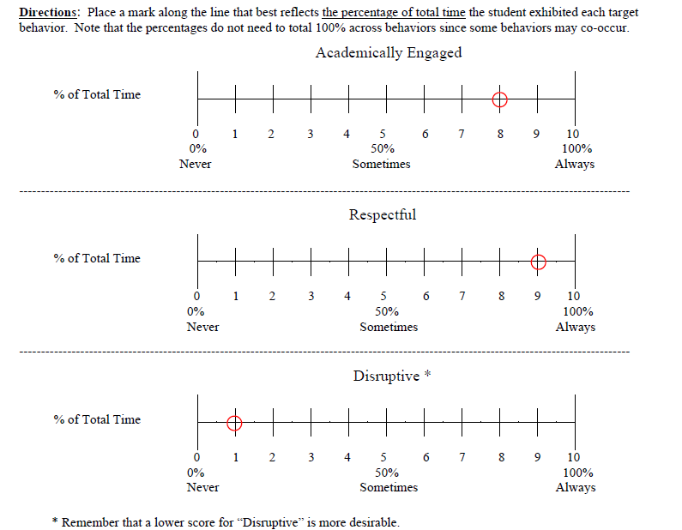
DBR-SIS
AE
RS
DB
Core
Behavioral Competencies

Slide 21
Using a Composite Score
Academic Engagement (0-10)
AE: Actively or passively participating in the classroom activity.
Example: Determining the average individual score
AE-1 8
AE-2 9
AE-3 10
AE-4 6
AE-5 8
AE-6 7
Average 8
Respectful (0-10)
RS: Compliant and polite behavior in response to adult direction and/or interactions with peers and adults.
Example: Forming the Composite
AE 8
RS 9
DB 8 (10-2 = 8)
C 25
Disruptive Behavior (0-10 – reverse)
DB: A student action that interrupts regular school or classroom activity.
Core Composite (0-30)
C: Sum of scores across individual targets of AE, RS, and DB (reverse scored).

Slide 22
Proposed Cut Scores: DBR-SIS Johnson et al., in press
Strengths
Weaknesses
 | Fall | Winter | Spring
 | Lower Elementary (1-2)
Composite cut score | 26.2 | 26.4 | 26.5
 | Upper Elementary (4-5)
Composite cut score | 27.3 | 26.8 | 27.8
 | Middle School (7-8)
Composite cut score | 27.5 | 28.2 | 28.1

Slide 23
Criterion Referenced Rating Scale
Student Risk Screening Scale (Drummond, 1994)
Primarily validated K-6 but evidence to support 7-12
7 indicators of antisocial behavior rated on 4-point scale
Completed only by teachers
Requires 10-15 minutes per class
Available for free online
No accompanying intervention materials
More recent expansion by Lane and colleagues to include internalizing and externalizing scale

Slide 24
Student Risk Screening Scale
Strengths
Weaknesses
Directions: Each classroom teacher will fill in the names of the students in alphabetical order (use additional sheets of this Scale as needed). Rate all of the students on each behavior using the following scale: 0=Never, 1=Rarely, 2=Occasionally, 3=Frequently. At the bottom of page 2, please summarize the number and percent of students in each risk category.
The total scores range from 0 to 21, forming three risk categories:
(L) Low Risk (0 to 3) (M) Moderate Risk (4 to 8) (H) High Risk (9 to 21)
Student Name | Steal | Lie, Cheat, Sneak | Behavior Problem | Peer Rejection | Low Academic Achieve-ment | Negative Attitude | Aggressive Behavior | Total (0-21) | Risk (circle)
1. |  |  |  |  |  |  |  |  | L M H
2. |  |  |  |  |  |  |  |  | L M H
3. |  |  |  |  |  |  |  |  | L M H
4. |  |  |  |  |  |  |  |  | L M H
5. |  |  |  |  |  |  |  |  | L M H
6. |  |  |  |  |  |  |  |  | L M H
7. |  |  |  |  |  |  |  |  | L M H

Slide 25
Criterion Referenced Rating Scale
SSIS Performance Screening Guide (Elliott & Gresham, 2007)
Preschool to Grade 12
All students rated on 4 dimensions (Prosocial, Motivation to Learn, Reading Skills, Math Skills)
Forms available for teachers
25-30 minutes typically needed to screen a class
$46 for package of 10 forms
Online scoring available
Links to SSIS Intervention Guide
Strengths
Weaknesses

Slide 26
Systematic Screening for Behavioral Disorders
Teacher screening using rank-order procedures
Teacher rating of critical behavioral problems
Observation of in-class/playground behavior
Pre-referral intervention team
Strengths
Weaknesses

Slide 27
Summary
Variety of different screening options exists, each with different strengths and weaknesses
Think about contextual fit, defensibility, & logistics
What indicators of student functioning are most meaningful given your population?
Strong evidence for reliability and validity of scores?
Feasibility? Acceptability?
How will these data inform intervention provision?

Slide 28
Screening Considerations

Slide 29
Miller et al., 2015
Notes:
Main point: Scope varies considerably in who we identify by measure

Slide 30
Essentials
Ethical considerations (Chafouleas, Kilgus, & Wallach, 2010)
Must establish follow up procedures when children identified at risk
Conduct more thorough assessment to verify problem
Intervention/treatment options must be available to address identified concerns
Consider district policies regarding parental consent
Active?
Passive?
None?

Slide 31
How often to screen?
Differing recommendations, ranging from once per year to three times per year
Bruhn et al. (2014)
39% once per year
23% twice per year
12% three times per year
26% other

Slide 32
Risk patterns by measure (Miller et al., in preparation)
Miller et al. (in preparation)

Slide 33
Which tools are best matched?
Frequency
What resources are available?
Time
Cost
Training
Supports
Informant
Scope

Slide 34
Questions to guide decision making (Lane et al., 2012)
What grade level are you working with?
What types of concerns are you interested in identifying?
Who do you want to do the ratings (e.g., teachers, parents, students)?
What is your budget?
How much time can you devote to screening?
Is paper and pencil OK or do you prefer electronic?
Are you looking for a screener that links to intervention?
What are your school/district’s policies regarding screening?

Slide 35
Questions/Comments?
Dr. Faith Miller: fgmiller@umn.edu
Dr. Sandra Chafouleas: sandra.chafouleas@uconn.edu
This presentation was supported in part through project funding provided by the Institute for Education Sciences: R305A140543, R324A110017.

